Slide 1
CS414 P1 Presentation
Team ‘We Them Boys’ - Legan Chess

Slide 2
Who are “Them Boys”?
Alex Guentchev
Lance McMullin
Westin Musser
Jesse Schmidt
Joseph Tonski

Slide 3
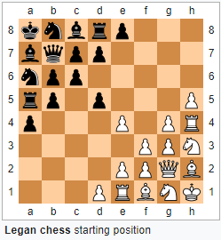
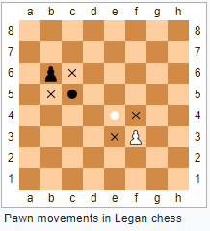
The XGame: Legan Chess
Invented by L. Legan in 1913.
Pieces start in the corners, as illustrated
Pawn movement changes
No castling, and no en passant
Graphics from https://en.wikipedia.org/wiki/Legan_chess

Slide 4
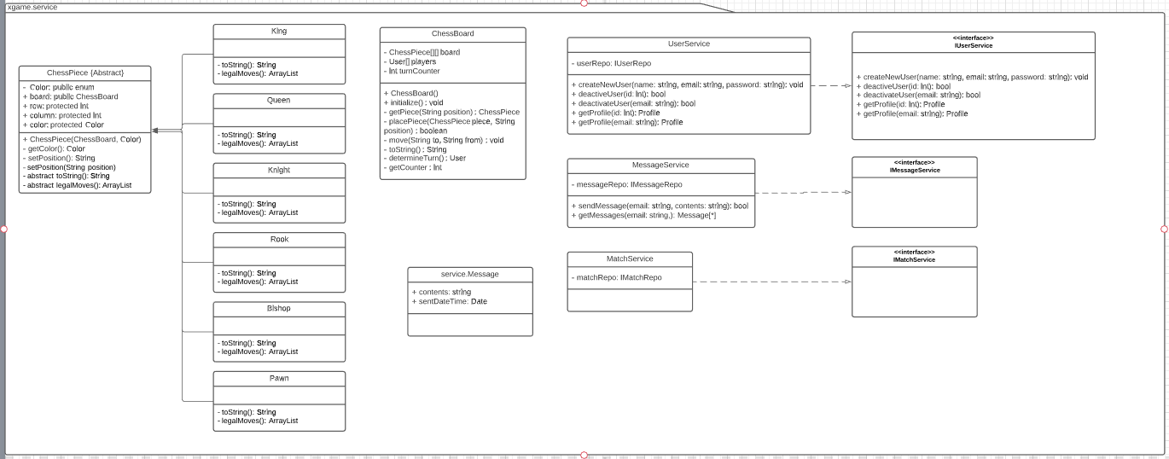
Development Progress: Service Layer Class Diagrams

Slide 5
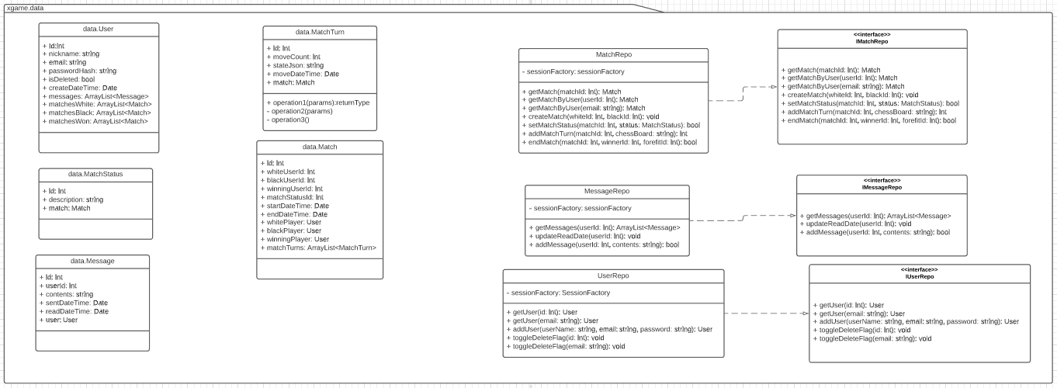
Development Progress:Data Layer Class Diagrams

Slide 6
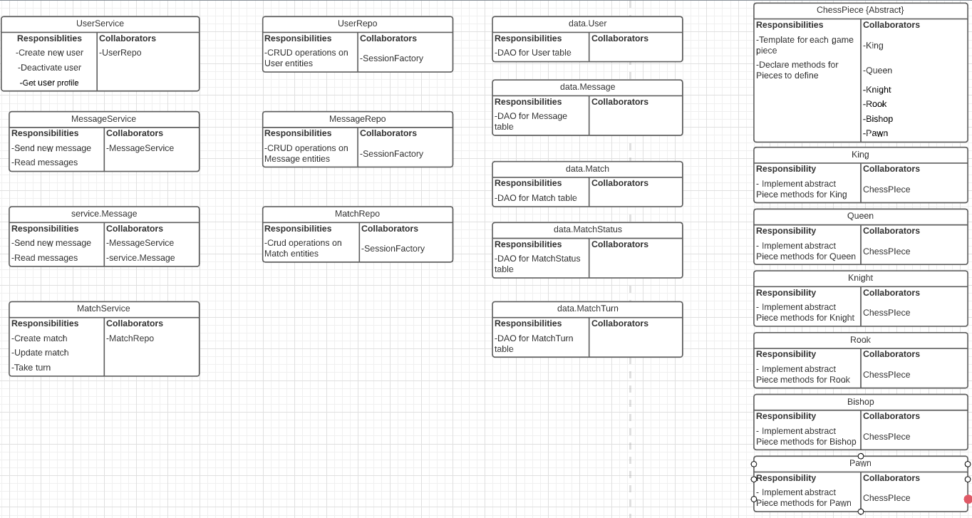
Development Progress: CRC Cards

Slide 7
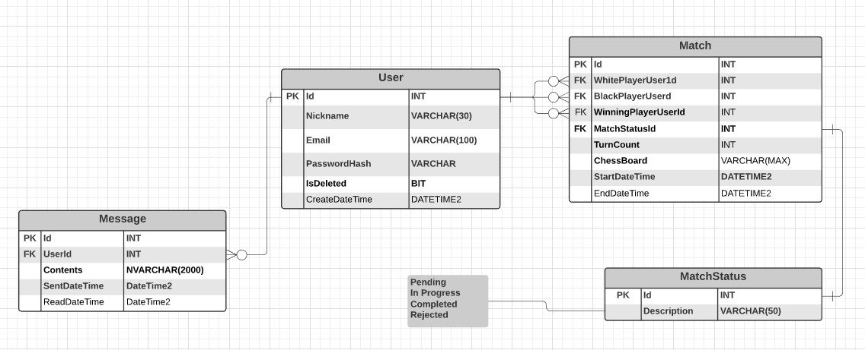
Development Progress: Database Diagram

Slide 8
Development Tools
React
NPM
Node.js
Webpack
Java
JUnit
Spring MVC Framework
Hibernate
Maven
Architecture Design
Web Application
Model-View-Controller
Dependency Injection
N-tier Architecture
Repository pattern
Development Environment
Eclipse
Intellij
Azure DevOps
GitHub
Documentation
Lucidchart
OneNote
Communication
Discord
Teams

Slide 9
Scrum Ceremonies
We met with the Product Owner to discuss user stories and begin the planning stage.
There was not enough technical progression to merit a sprint Review meeting.
Retrospective:
What went well:
Good communication
Relatively regular meetings
Good team synergy
What didn’t go well:
Confusion around scrum process and when to include Product Owner
Inconsistent meeting times
Plan moving forward:
Have a consistent meeting schedule
Scrum accountability
More interaction with Product Owner

